Slide 1

Statistics for CSAI II
10 – Multiple Regression with Polynomials
Travis J. Wiltshire |

Slide 2
Outline
Introduction and Probability
Sampling Theory
Revisiting Hypothesis Testing & Intro to Correlation
Correlation
Intro to Regression
More Regression Centering and Checking Assumptions
Multiple Regression and Assumptions
Interactions
Multiple Regression with Categories
Multiple Regression with Polynomials
Mixed Models
Growth Curve Analysis
2

Slide 3
Outline
Polynomial regression
When to use it
How to do it in R
Orthogonal polynomials
2

Slide 4

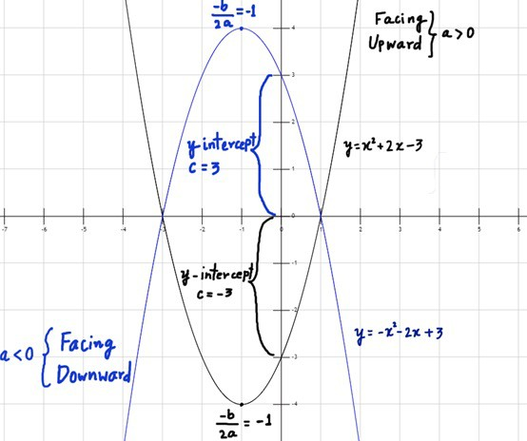

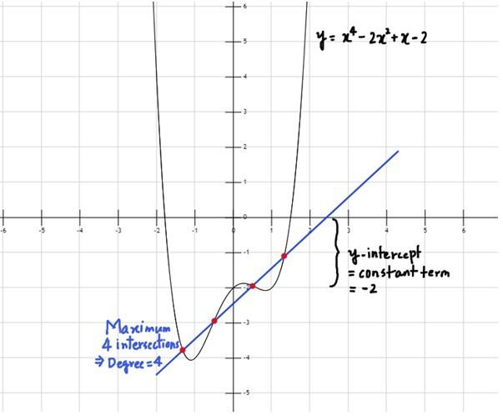
Refresher: Types of polynomial functions
Constant Polynomial Function:
P(x) = a = ax0
Zero Polynomial Function:
P(x) = 0; where all ai’s are zero, i = 0, 1, 2, 3, …, n.
Linear Polynomial Function:
P(x) = ax + b
Quadratic Polynomial Function
P(x) = ax²+bx+c
Cubic Polynomial Function:
P(x) = ax³+bx²+cx+d
General form of Higher Degree Polynomial Function:
P(x) = a_{n}x^{n} + a_{n-1}x^{n-1}+…+ a₀, where a₀,a_{1…},a_{n} are all constants.
Quadratic
Higher degree (Quartic)
From: https://byjus.com/maths/polynomial-functions/

Slide 5
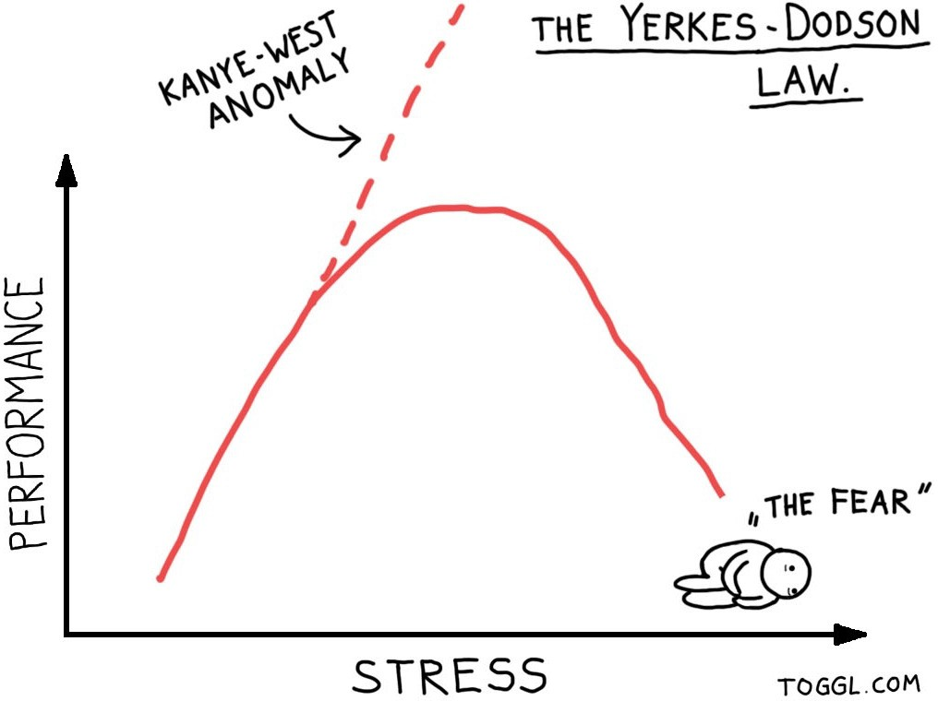
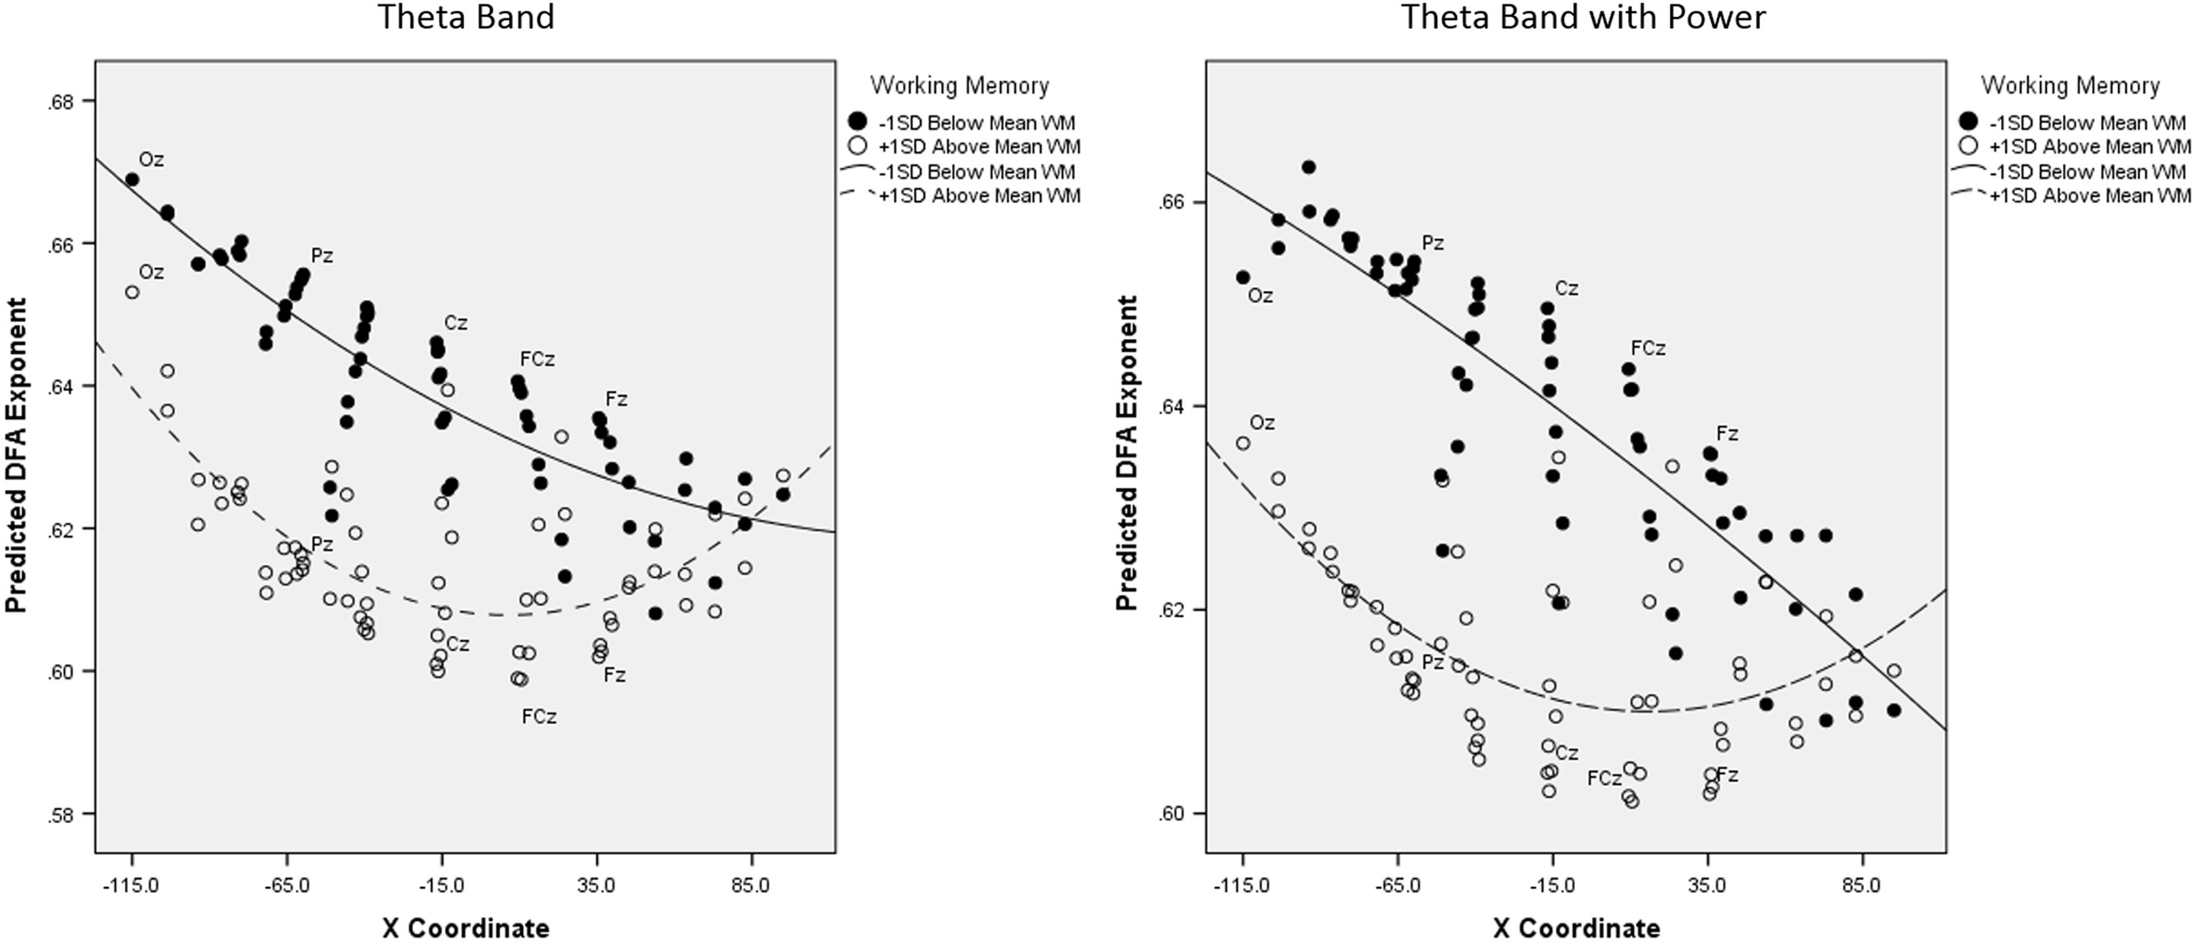
When to consider polynomial regression
Theoretically: When you have theory or a reason to expect the relationship between your predictor and your outcome to be curvilinear
Some examples:
Learning, skill acquisition
Developmental stages
Stress responses
Attention and memory capacities
Attitudes and preferences over time
Euler, M. J., Wiltshire, T. J., Niermeyer, M. A., & Butner, J. E. (2016). Working memory performance inversely predicts spontaneous delta and theta- band scaling relations. Brain research, 1637, 22-33.

Slide 6
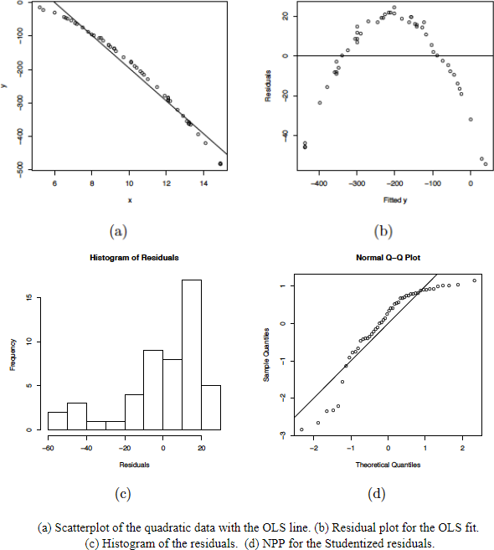
When to consider polynomial regression
Empirically: When you check out your scatterplots and other plots for checking the assumptions of your linear model
  Residuals vs fit
  Histogram of residuals
  QQ plot

Slide 7
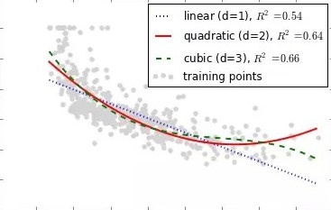
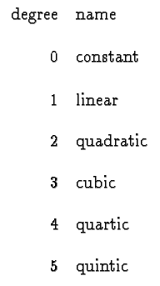
Polynomial Regression
The degree of the polynomial determines the number of points of inflection (d-1)
Must include all lower order terms
Be careful of overfitting data (generalizability of the model)
Practical significance vs statistical significance
Coefficients tell us direction and strength/depth of curve(s)

Slide 8
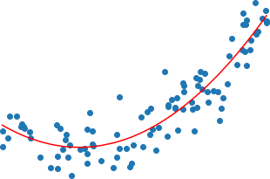
Interpreting Polynomial Regression Results
Plot them!
Quadratic term:
  Positive = curve opens upward (apex is lowest value)
  Negative = curve opens downward (apex is highest values)
Focus is more on overall model comparisons and the shape of the trend vs interpretation of individual coefficients

Slide 9
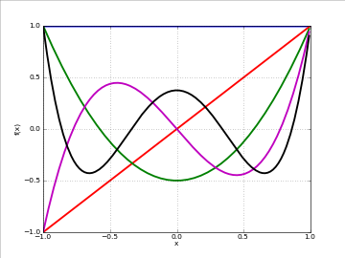
Running the model in R
Manually create the polynomial terms
  E.g., arousal2<-arousal*arousal
  arousal3<-arousal*arousal*arousal
Add directly into lm() formula
  outcome ~ pred + I(pred^2)

Slide 10
Run multiple regression on the data
Load the yerkes.dods.csv data file from Canvas
Inspect the data and generate descriptive statistics
Run and save linear model with perf as the outcome and arous as the predictor
Interpret the results
Generate and inspect the following fitted vs residual plot, histogram of the residuals, and the qq plot
Now run and save the model adding a quadratic term (you can decide which method you want to do to add this)
Interpret the results

Slide 11
Multiple and Polynomial Regression
Y_{i} = b₀ + b₁X₁ + b₂X₂ + …b_{n}X_{n}+ ε_{i} Y_{i} = b₀ + b₁X + b₂X² + …b_{n}X^{n}+ ε_{i}
One dependent variable Y predicted from a set of independent variables (X1, X2
….Xk)
One regression coefficient for each independent variable
R²: proportion of variation in dependent variable Y predictable by set of independent variables (X’s)
One dependent variable Y predicted from a set of independent variables (X1, X2
….Xk)
One regression coefficient for each independent variable
Independent variables become variables raised to increasing degrees of the polynomial (the exponent they are raised to)

Slide 12
Compare your models
Compare your models using anova() and AIC
Which model fits better?
What is the change in the R²?
Now check out if you have any problems with multicollinearity (you may need to manually create the quadratic variable)

Slide 13
Essential vs. Nonessential Multicollinearity
Computing powers of a predictor variable X (X², X³, etc.) may result in predictors that are highly correlated with the original linear predictor
But all lower order terms should be included as predictors in the model as well (for interpretability) ⇒ multicollinearity!
Two types:
  Nonessential multicollinearity (merely due to scaling of non-zero mean of X) Solution: centering X before creating polynomial terms
  Essential multicollinearity (due to nonsymmetry in the distribution of X) Possible solution: orthogonal polynomial regression

Slide 14
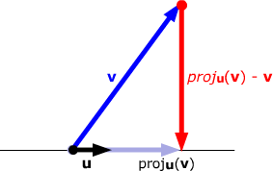
Orthogonal polynomials
A special class of variables that capture specific curve components (i.e., a transformation of the polynomial terms)
Reduces essential multicollinearity
But poses a challenge for interpretability because the coefficients do not directly relate to the original metric
Easy to do in R using poly() function in lm() formula
See here for more info (but this is non-essential): Video or visualizations or paper (Narula, 1979)

Slide 15
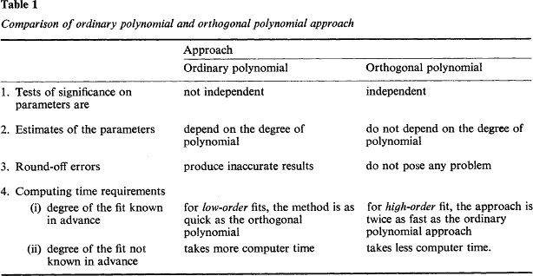
Narula (1979): Orthogonal Polynomial Regression

Slide 16
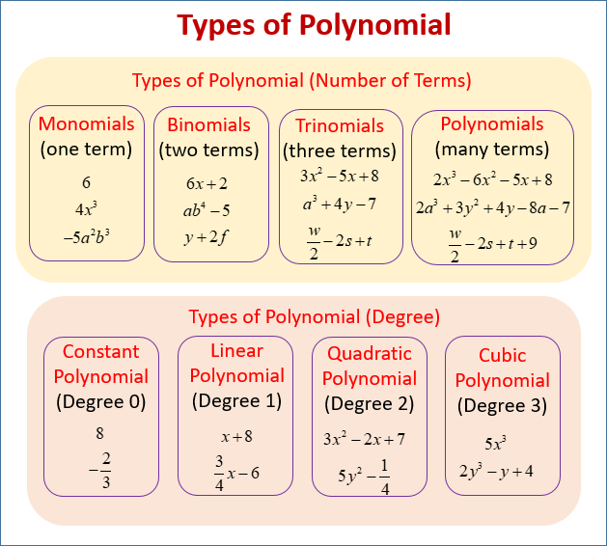
Recap
Polynomial regression is useful when:
  Predicted relationship between variables is curvilinear
  Checking assumptions and observe curve-like patterns
Must iteratively add polynomial terms of increasing order and all lower order terms
Interpretation: Comparing model fit
Sometimes polynomial terms can be too highly correlated with each other
  Create orthogonal polynomials
  In practice, patterns of results should be the same
-

Slide 17
Preparing for Module 11: Mixed models
Winter, B. (2013). Linear models and linear mixed effects models in R with linguistic applications. pp. 21-40. http://arxiv.org/pdf/1308.5499.pdf
Additional reading (optional) - https:// bookdown.org/roback/bookdown-BeyondMLR/ch- multilevelintro.html#twolevelmodeling
2

Slide 18
Thanks! See you next week! Questions?
Material from Cohen et al CH 8
16

